Slide 1

Nervous System
The nervous system or the neural system is a complex network of neurons specialized to carry messages. The complexity of the nervous system increases as we move towards higher .
For instance, cnidarians such as jellyfish have relatively simple nerve nets spread throughout their body. Crabs have a more complicated nervous system in the form of 2 nerve centers called dorsal ganglion and ventral ganglion.
As we move further up the ladder, higher organisms such as vertebrates have a developed brain. Moreover, it is one of the most complicated structures in the animal kingdom, containing billions of neurons, all intricately connected.
In the human body, the neural system integrates the activities of organs based on the stimuli, which the neurons detect and transmit. They transmit messages in the form of electrical impulses and convey messages to and from the sense organs. Thus, the nervous coordination involves the participation of the sense organs, nerves, spinal cord, and brain

Slide 2
The nervous system is responsible for sending, receiving, and interpreting information from all parts of the body. The nervous system monitors and coordinates internal organ function and responds to changes in the external environment. The central nervous system (CNS) functions as the processing center for the nervous system

Slide 3
  The anatomy of the nervous system in humans consists of the brain and spinal cord, along with the primary sense organs and all the nerves associated with these organs. The brain and the spinal cord form the central nervous system (CNS). All other neuronal tissue is brought under the umbrella of the peripheral nervous system (PNS). Therefore, the PNS includes neurons within sense organs, other sensory nerves, and all motor nerves that deliver messages to different parts of the body.

Slide 4
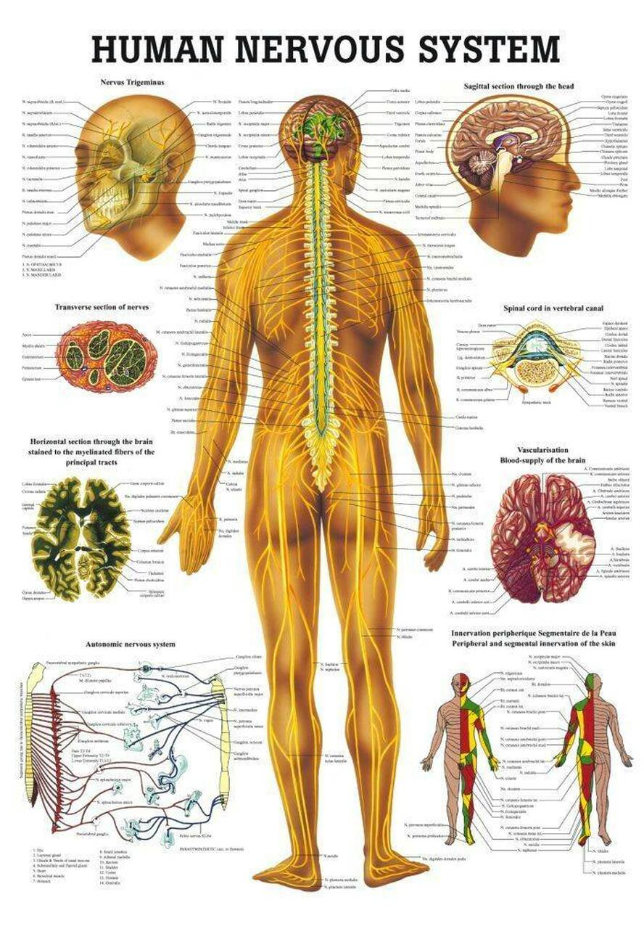

Slide 5
The four main functions of the nervous system are:
Control of body's internal environment to maintain 'homeostasis' An example of this is the regulation of body temperature. ...
Programming of spinal cord reflexes. An example of this is the stretch reflex. ...
Memory and learning. ...
Voluntary control of movement.

Slide 6
The neuron
neruon. 1- Basic parts of a
2- Soma or cell body
3- Neurites
4- Dendrites (afferent)
5- Axon (efferent

Slide 7
The nervous system is defined by the presence of a special type of cell—the neuron (sometimes called "neurone" or "nerve cell").^{[4]} Neurons can be distinguished from other cells in a number of ways, but their most fundamental property is that they communicate with other cells via synapses, which are membrane-to-membrane junctions containing molecular machinery that allows rapid transmission of signals, either electrical or chemical.^{[4]} Many types of neuron possess an axon, a protoplasmic protrusion that can extend to distant parts of the body and make thousands of synaptic contacts;^{[12]} axons typically extend throughout the body in bundles called nerves.
Even in the nervous system of a single species such as humans, hundreds of different types of neurons exist, with a wide variety of morphologies and functions.^{[12]} These include sensory neurons that transmute physical stimuli such as light and sound into neural signals, and motor neurons that transmute neural signals into activation of muscles or glands; however in many species the great majority of neurons participate in the formation of centralized structures (the brain and ganglia) and they receive all of their input from other neurons and send their output to other neurons

Slide 9
The neuron§ Soma, perikaryion or
cell body:
§ Nucleus
§ Structure:
§ Contains the DNA
§ In turn it has its own
membrane (nuclear
membrane)
§ Function:
§ Controls the neuron
activities

Slide 11
The neuron
§ Molecular machines and gene expression
§ The “reading” of the DNA is known as gene expression
[BearMF2007].
§ The final product of gene expression is the synthesis of a
protein (protein synthesis) which occurs in the
cytoplasm.
§ Every cell in the human body, and neurons in particular,
contains a collection of molecular machines that serve as
factories for the production and shaping of proteins, lipids
and other macromolecules [Dean T (2013) “Scalable
Neuroscience and the Brain Activity Mapping Project”].
§ Molecular machines are tiny energy conversion devices on the
molecular-size scale composed of proteins, DNA and other
compounds [Mavroidis et al (2004) Annu. Rev. Biomed. Eng.,
6:363-95] (e.g. organelles).
c

Slide 12
Soma, perikaryion or
cell body:
§ Membrane;
§ Structure: A lipid bilayer
wall
§ Function:
§ Separates the neuron
from its environment
(extracellular space)
enclosing other
organelles.
§ Selectively permeable
to ions and molecules
c 2015-8. Dr. Felipe Orihuela-Espina 12

Slide 15
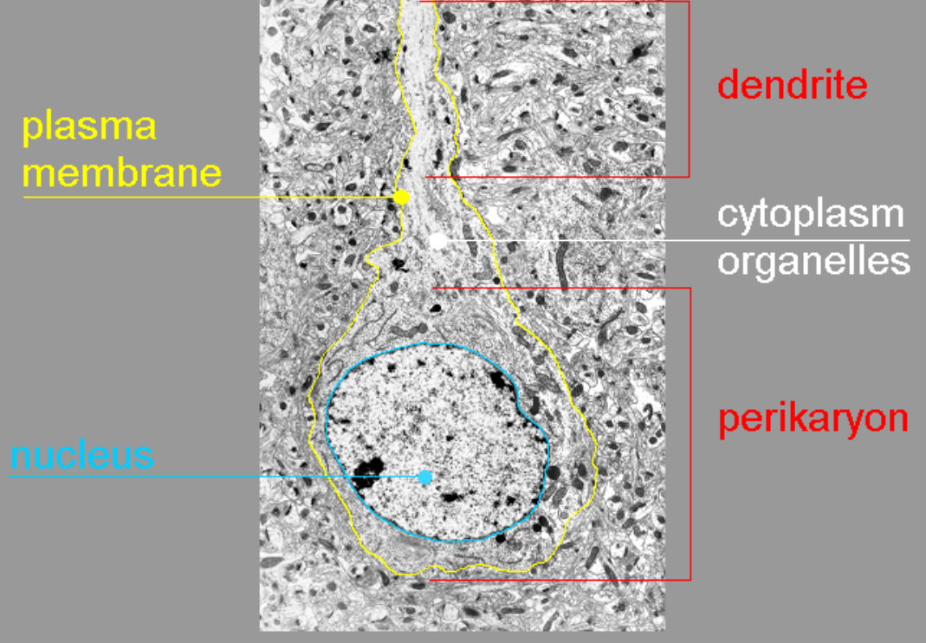
Soma, perikaryion or cell
body:
§ Cytoplasm; the total content
within the cell membrane other
than the nucleus
§ Structure:
§ Molecular compounds inc.
enzymes, carbohydrates,
lipids, aminoacids, etc
§ It includes the cytosol, as well
as other organelles including
mitochondrion, golgi
apparatus, vacuoles, plastids,
cell wall (membrane) and the
endoplasmic reticulum.
§ Function:
§ Non-chemical metabolic paths
§ Cell-division
§ ☞ NOTE: Cytoplasm and
organelles are not confined to
the soma.

Slide 16
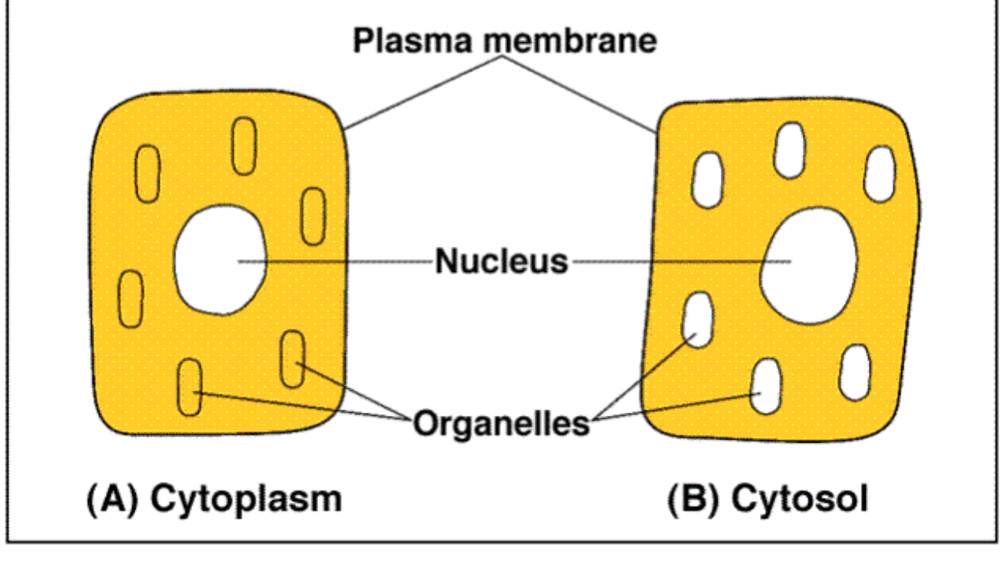
Soma, perikaryion or
cell body:
§ Cytosol; fluid inside
the cell.
§ Structure:
§ Water and dissolved
ions
§ In the neuron; rich in
potassium
§ Function:
§ Excellent conductor of
electricity
§ All the metabolic
chemical reactions
occurs here

Slide 17
Soma or cell body:
§ Mitochondrion;.
§ Structure:
§ bean-shaped with
inner membranes
§ Has its own DNA.
§ Function:
§ breaks down sugar
molecules into energy
(generating most of
cell’s ATP)

Slide 18
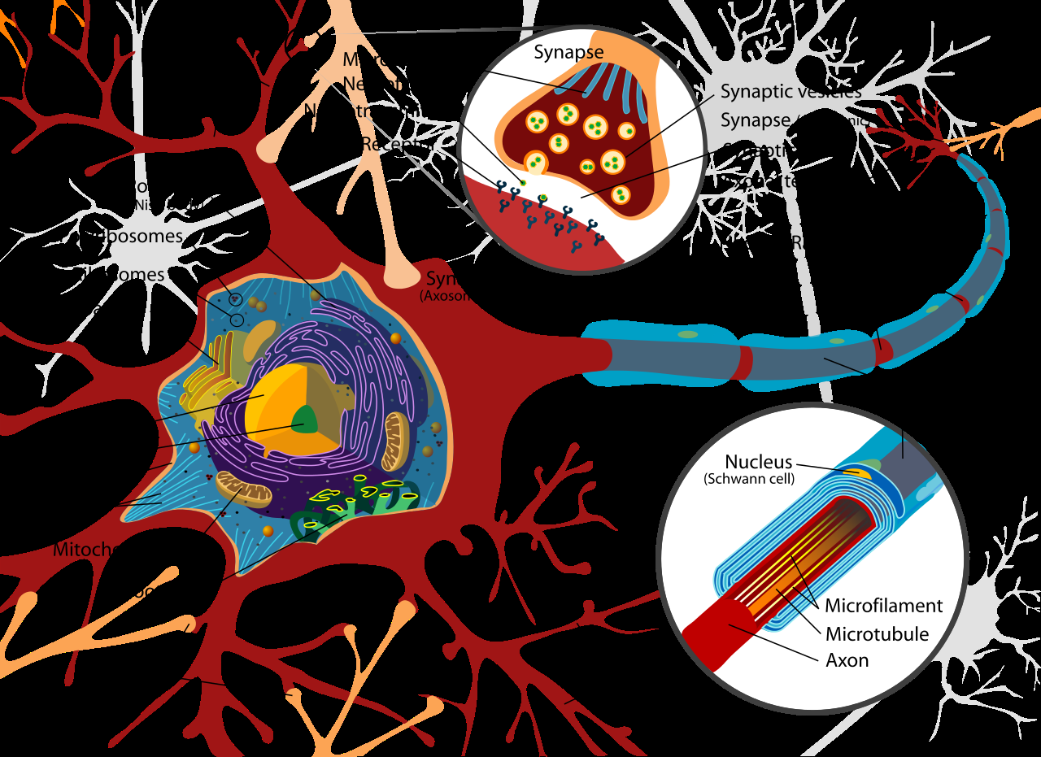
Soma or cell body:
§ Other organelles:
§ Ribosome: produces
proteins
§ Vacuole: Sacs for storing
food, water and waste
§ Lysosome: Breaks large
molecules into smaller
colecules
§ Endoplasmic reticulum
(ER): A network of tubes
(membranes) for carrying
material, final folding of
proteins
§ Golgi apparatus: Packaging
of materials for the ER,
manufacturing of
membranes
c

Slide 20
We won’t see these other organelles in detail
as they are less directly involved in metabolism;
but they are essential to the brain activity;
remember it’s all about reading DNA and
producing proteins (protein synthesis).
§ To know more:
§ [Bear MF, Connors BW, Paradiso MA (2007)
“Neuroscience: Exploring the brain” Lippincott
Wiliams and Wilkins, 2nd Ed.]

Slide 21
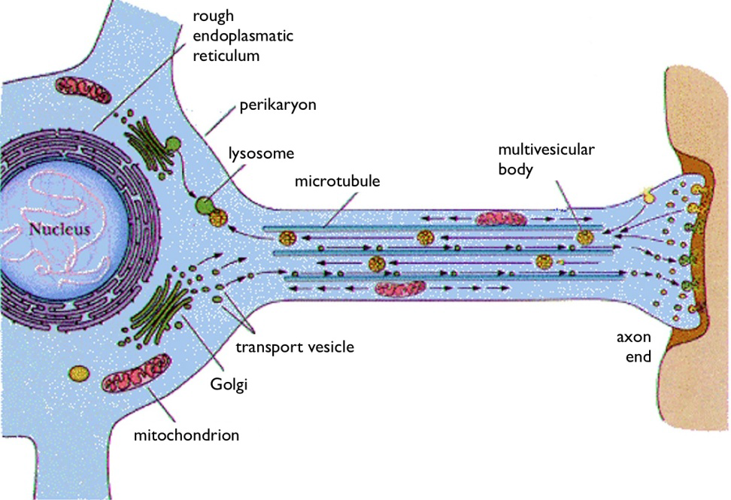
Axon:
§ Structure:
§ A long fibre
§ Contains voltage-gated
channels
§ Function:
§ Send neural signals
through synaptic
connections from other
neurons

Slide 23
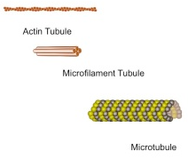
Axon:
§ Scaffolding:
§ Three basic types:
§ Actin tubules
§ intermediate microfilaments,
§ Larger microtubules
§ Function:
§ Actin: Builds a membrane’s moving
edge for a growing axon or dendrite.
§ Microfilaments: flexible, make strong
connections by elaborate branching
§ Microtubules: Highways for transport
of materials, mitochondria and
vesicles
§ Many neuro-degenerative diseases
can be traced to dysfunction of
microtubules e.g. Alzheimer might
be due to disintegration of tau
molecules that provide strength and
stability to the microtubule
structures.

Slide 24
Axon:
§ Myelin Sheath
§ A sheath surrounding axons
§ ☞ NOTE: Not all axons are myelinated; some are unmyelinated. This
affects to how the electrical signal is propagated.
§ Structure:
§ Myelin (fatty membrane)
§ The “holes” in the sheath; that is the naked portion of a myelinated
axon are called nodes of Ranvier.
§ Function:
§ Insulate axon
§ Prevent messages from spreading to other neurons

Slide 25
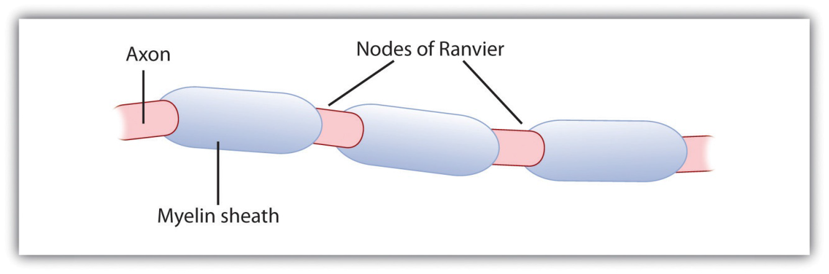

Slide 26
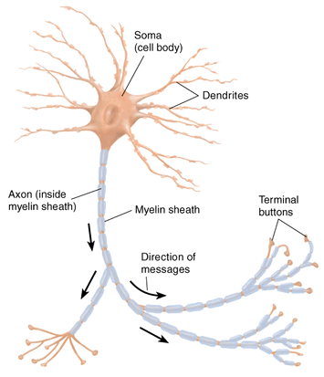
Axons:
§ Terminal Buttons:
endings of the neurites
§ Function:
§ Release
neurotransmitters into
synapses.

Slide 27
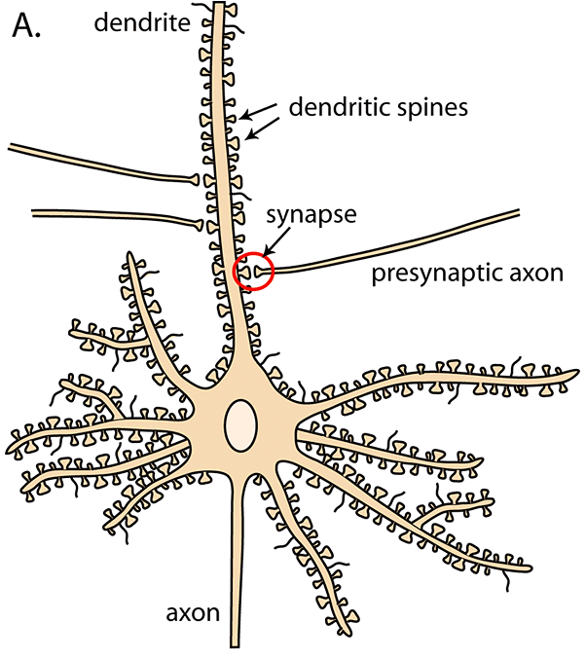
Dendrites:
§ Structure:
§ tree-branch like fibres
§ Contain a large number
of dendritic spines that
form contacts, or
synapses, with other
neurons.
§ Function:
§ Receive neural signals
through synaptic
connections from other
neurons

Slide 28
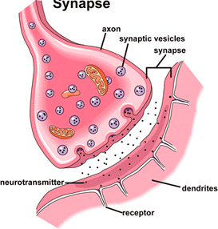
Synapse:
§ Synapses are the gaps
between adjacent
neurons across which
chemical signals are
transmitted.
§ Synaptic vesicles: small
spherical membranes
that store
neurotransmitter
molecules and release
them into synaptic cleft.

Slide 29
Classification of neurons
according to their
connections (function);
§ Primary Sensory Neurons:
Neurites connected to
sensory surfaces of the
body (e.g. Skin, retina, etc)
§ Motor Neurons: Connected
to muscles.
§ Interneurons: Connectes
to other neural cells

Slide 30
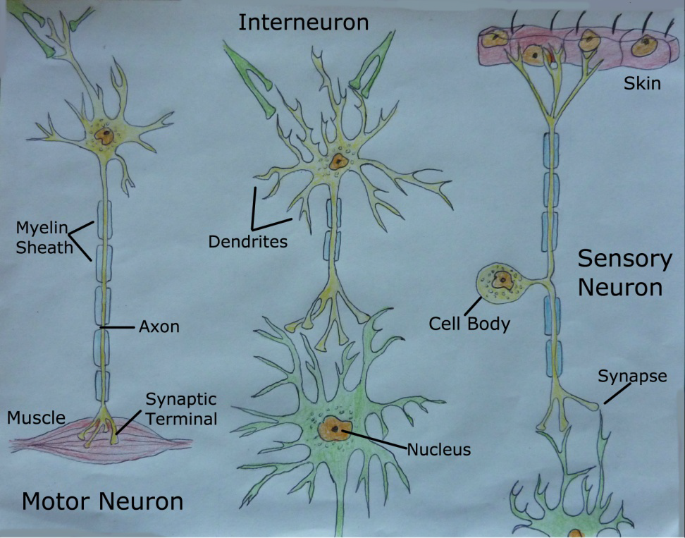

Slide 31
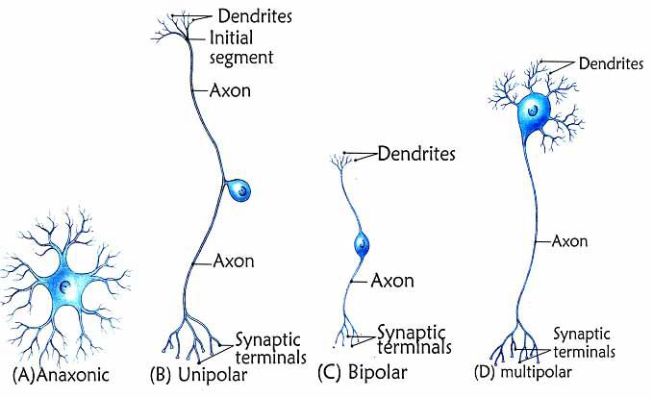
Classification of neurons
according to their number of
neurites;
§ Unipolar Neurons: a unipolar
neuron has one axon with two
branches attached to its soma
§ Most sensory neurons are
unipolar
§ Bipolar Neurons: a bipolar
neuron has one axon and one
dendrite attached to its soma
§ Many interneurons are bipolar
§ Multipolar Neurons: a multipolar
neuron has one axon and many
dendrites attached to its soma

Slide 32
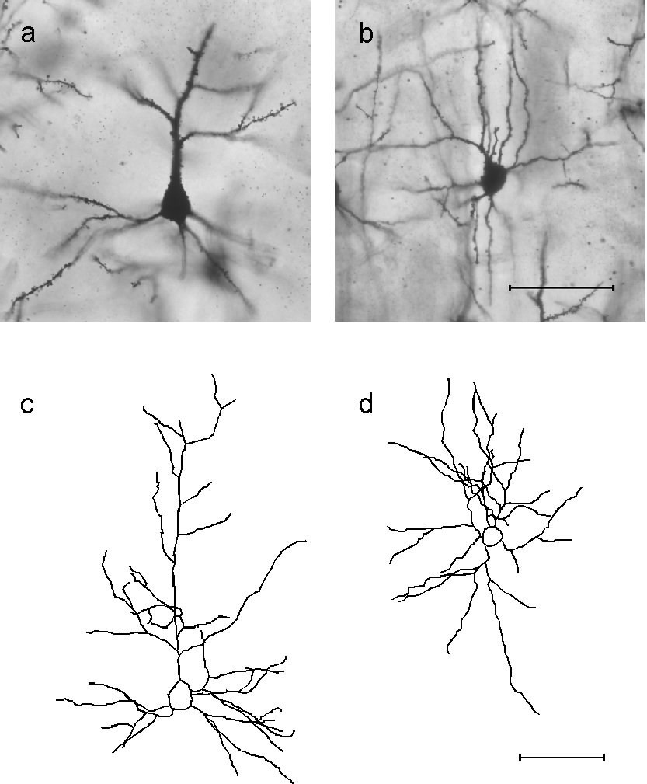
Classification of
neurons according to
their dendritic tree
structure;
§ Stellated Neurons: star
shaped
§ Pyramidal Neurons:
pyramid shaped.

Slide 33
§ Classification of neurons according to their
axon length;
§ Golgi Type I Neurons: long axons
§ Necessary to cross the brain.
§Most pyramidal neurons are type I.
§ Golgi Type II Neurons : short axons.
§ Necessary for local circuits
§Most stellate neurons are type II.
§Most type II are anaxonic.
c

Slide 34
There are other classification, not
necessarily morphological
§ E.g. classification according to the
neurotransmitter used, electrophysiological
properties, molecular characteristics, etc
§ In fact, the number of types of neurons in the
brain remains an open question
[SharpeeTO2014].
§ We won’t get into further details. To know
more:
§ Sharpee TO (2014) Neuron 83:1329-1334]
c

Slide 35
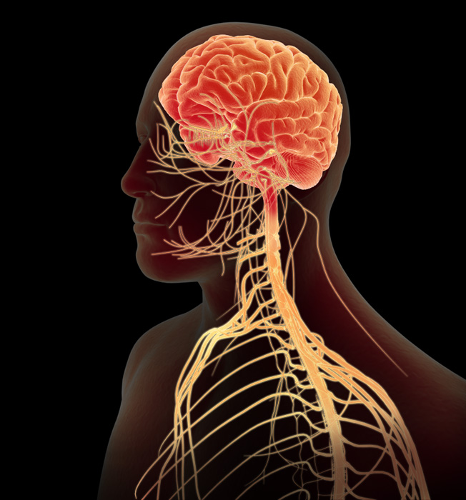
BRAIN
Brain
The brain is one of the important, largest and central organ of the human nervous system. It is the control unit of the nervous system, which helps us in discovering new things, remembering and understanding, making decisions, and a lot more. It is enclosed within the skull, which provides frontal, lateral and dorsal protection. The human brain is composed of three major parts:
1.Forebrain: The anterior part of the brain, consists of Cerebrum, Hypothalamus and Thalamus.
2.Midbrain: The smaller and central part of the brainstem, consists of Tectum and Tegmentum.
3.Hindbrain: The central region of the brain, composed of Cerebellum, Medulla and Pons.

Slide 36

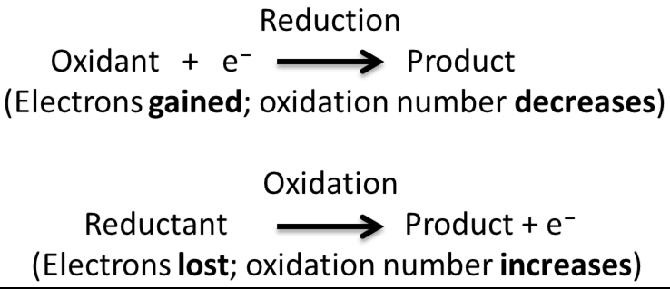
Reduction is a gain of electrons
§ Originally meant loss of oxygen, and
then generalised to gain of
electrons.
§ Reducing agents remove oxygen
from another substance (the agent
losses electrons)
§ Oxidation is a loss of electrons
§ Originally meant gain of oxygen, and
then generalised to loss of electrons.
§ Oxidising agents give oxygen to
another substance (the agent gains
electrons)
§ Redox: An oxidation-reduction
reaction
§ There cannot be an oxidation
reaction without a reduction reaction
happening simultaneously.
c

Slide 37
Respiration
§ (Cellular) respiration is the set of metabolic
reactions by which nutrients are converted
into energy in a cell.
§ It can be aerobic (with oxygen) or anaerobic
(without oxygen)
§ It involves redox reactions
§ (Physiological) respiration refers to the
transport of oxygen and carbon dioxide
between cells and the external environment

Slide 38
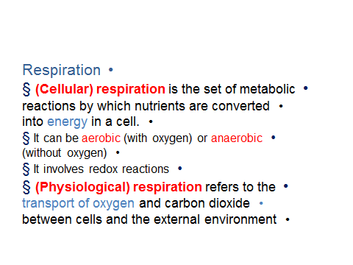
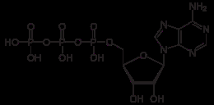

Respiration
Adenosine triphosphate (ATP) is the basic
molecule for energy storing, transport and
release in cells.
§ Energy storing: During cellular respiration glucose
and oxygen are converted into adenosine
triphosphate (ATP), and produce carbon dioxide
as a waste product.
§ ATP can be produced by redox reactions using
simple and complex sugars (carbohydrates) or
lipids as an energy source
§ Energy transport: ATP transports chemical energy
within cells for metabolism.
§ It does so by either “navigating” in the
cytoplasm, or by moving substances across cell
membranes.
§ Energy release: Energy stored in ATP may be
released upon hydrolysis (adding a molacule of
(those
that connect adjacent phosphates)
are responsible for the high energy
content of ATPwater to a substance) of the anhydride bonds
Adenosine = Adenine + Ribose sugar
Three phosphate
groups
Ribose sugar
(those
that connect adjacent phosphates)
are responsible for the high energy
content of ATP.

Slide 40
NAD(H) – (Reduced/oxydized) Nicotinamide adenine dinucleotide (NAD) is a
coenzyme which can then be used as a reducing agent to donate electrons.

Slide 42
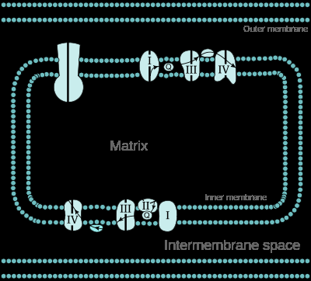
Chemiosmosis is the movement
of ions across a selectively
permeable membrane, down their
electrochemical gradient.
§ More specifically, it relates to the
generation of ATP by the movement
of hydrogen ions across a
(mitochondrion) membrane during
cellular respiration or photosynthesis
(oxidative phosphorylation).
§ Hydrogen ions (protons) will diffuse
from an area of high proton
concentration to an area of lower
proton concentration, and an
electrochemical concentration
gradient of protons across a
membrane can be harnessed to
make ATP.

Slide 43
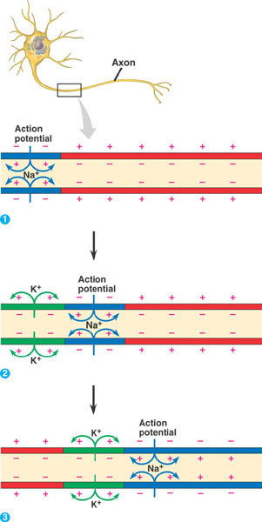
Brain function
Action potentials are brief,
rapid, large changes in the
membrane potential in
which the potential actually
reverses.
§ Action potentials are
propagated/conducted
along the axon of a neuron
without losing their strength
(nondecremental
conduction)

Slide 44
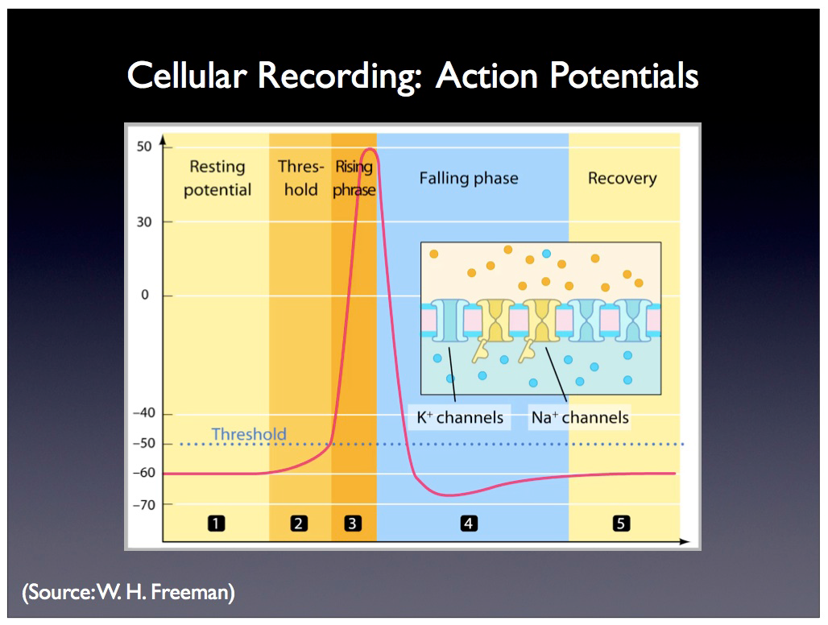
The action potential:
§ An animation of the action potential

Slide 45
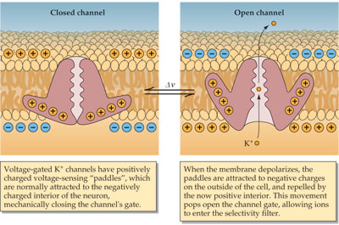
Ion channels are integral membrane
proteins with a pore through which ions
can travel between extracellular space
and cell interior (passive transport).
§ There are four main types of gated
channel.
§ Voltage-gated channels (open/close in
response to a change in membrane
potential)
§ Chemically-gated ion channels a.k.a.
ligand*-gated (open/close in response to
binding with an extracellular chemical
messenger (neurotransmitter))
§ Mechanically-gated ion channels
(open/close in response to physical
stimuli)
§ Thermally-gated channels (open/close in
response to temperature changes

Slide 46
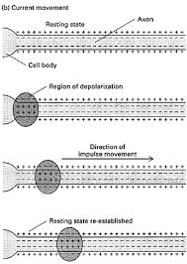
§ The cell membrane of the
axon and soma contain
gated ion channels that
allow the neuron to
generate and propagate
an electrical signal (an
action potential).
§ These signals are
generated and
propagated by chargecarrying
ions.
§ Ions, not electrons, are the
carriers of current in the
nervous system.

Slide 47
Step 4. As sodium
rushes in, the inside
becomes positive, and
that forces out
potassium.
Step 2. When a neuron
is stimulated,
molecular receptors in
its membrane open
Step 1. A resting (diffusion)
membrane potential normally
exists through the efflux of
positive-charged (potassium)
ions maintaining
an electrochemical equilibrium
of –75 mV.
Step 3. Sodium ions move in
because their is an electrical
pulling force (inside is negative
and sodium ions are positive) and
an osmotic force (sodium is more
concentrated on the outside).

Slide 48
Brain function

